Slide 1

Turning to the Functional side (Using C# and F#)
Phil Trelford
http://trelford.com/blog @ptrelford
Tomas Petricek
http://tomasp.net/blog @tomaspetricek

Slide 2
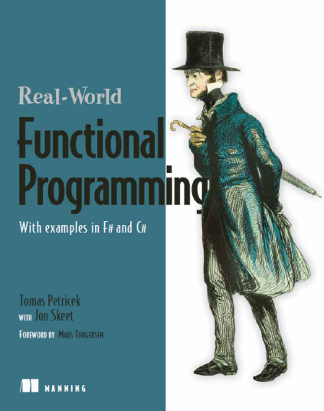
About Us
Tomas
Author of F# book for C# programmers
Worked with the F# team at Microsoft
First blogged about F# in May 2006
Phil
Software Developer and Architect
Worked on first F# applications at Microsoft
Co-organizer of London F# User Group
Courses at SkillsMatter
http://functional-programming.net

Slide 3
http://tomasp.net/fpday.zip
Processing Stock Prices

Slide 4
Yahoo Stock Prices
Data stored in a CSV file
Read and print all data
Date,Open,High,Low,Close,Volume,Adj Close
2011-10-12,407.34,409.25,400.14,402.19,22206600,402.19
2011-10-11,392.57,403.18,391.50,400.29,21609800,400.29
2011-10-10,379.09,388.81,378.21,388.81,15769200,388.81
open System.IO
let dir = __SOURCE_DIRECTORY__ + "\\data\\aapl.csv"
let lines = File.ReadAllLines(dir)
for line in lines do
printfn "%s" line

Slide 5
Parsing CSV data
Get some data for testing
Using arrays in F#
Converting strings to numbers
let line1 = lines |> Seq.head
let line2 = lines |> Seq.skip 1 |> Seq.head
let arr = str.Split([| ',' |])
arr.[0]
float "12.34"
DateTime.Parse("1985-05-02")

Slide 6
Iterate over lines, parse CSV and print date & price
TASK #1

Slide 7
Sequence expressions
Exploring data using imperative loops
Can be turned into a sequence expression…
Result has a type seq<int * float> (IEnumerable)
Brackets: [| … |] for arrays, [ … ] for lists, set [ … ] for sets
for year, value in yearlyAverages do
if value < 25.0 then
printfn "%d (only %f)" year value
let badYears =
seq { for year, value in yearlyAverages do
if value < 25.0 then
yield year, value }

Slide 8
Turn the parsing into a sequence expression
TASK #2

Slide 9
Organizing Source Code
Compiled Libraries
Allow C# users call F# code
Encapsulate (complete) functionality
F# Script Files
Great for explorative programming
Script can load some other files
// File1.fsx
module StockData
let getData name =
name, 99.0
// File2.fsx
#load "File1.fsx"
open StockData
getData "MSFT"

Slide 10
Write function that parses specified CSV file
TASK #3

Slide 11
Processing Data in F#
Writing data processing query in F#
Seq module provides functions for IEnumerable
But some operations make only sense for arrays/lists
Sequence expressions provide query-like syntax
Lambda function
All types are inferred
StockData.MSFT
|> Seq.filter (fun stock -> stock.Close - stock.Open > 7.0)
|> Seq.map (fun stock -> stock.Date)
|> Seq.iter (printfn "%A")
Partial function application
Custom operators

Slide 12
Useful functions
Basic Functions
Seq.filter – filter elements using predicate (aka Where)
Seq.map – turn values into different (aka Select)
Aggregating all elements of a sequence
Seq.max, Seq.min, Seq.averag – the obvious
Seq.fold – general aggregation
Grouping elements of a sequence
Seq.groupBy – group using key
Seq.pairwise – adjacent pairs
Seq.windowed – sliding window
For more see: http://fssnip.net/categories/Sequences

Slide 13

Calculate standard deviation of the data
TASK #4
Find number of days when closing price is larger than opening price by more than $5.
TASK #5
$$\sqrt{\frac{\sum{{(v_{i}−avg)}^{2}}}{count}}$$

Slide 14
FSharpChart library
Easy to use charting library for F#
Based on .NET 4.0 Chart Controls (WinForms/ASP.NET)
Designed to fit nicely with F#
Light-weight syntax for projections
Line chart expects value or key * value
[ for st in StockData.MSFT -> st.Date, st.Open ]
|> FSharpChart.Line
[ for st in StockData.MSFT -> st.Date, st.Open ]
|> FSharpChart.Line
|> FSharpChart.WithTitle
( Text = "Microsoft Stock Prices",
Font = new System.Drawing.Font("Calibri", 16.0f) )

Slide 15
Create chart that shows values with 5 day average. This can be done using Seq.windowed
TASK #6
TASK #7
Create chart that shows prices together with standard deviation (over 5 day window) range

Slide 16
Processing data live and in parallel
Observable
Source generates data (push-based model)
Process data on-the-fly
F# libs and .NET Rx
Parallel Sequence
Parallel implementation
Process large amount of in-memory data
Available in F# PowerPack
In-memory, but processed in parallel
prices |> Seq.windowed 100
|> PSeq.ordered
|> PSeq.map averageAndSdv
Processing live data on the fly
pricesEvent |> Observable.windowed 100
|> Observable.map averageAndSdv

Slide 17
Async Programming

Slide 18
The Problem
Problems with I/O bound computations
Avoid blocking user interface
Handle many requests concurrently
What needs to be done differently?
Avoid creating and blocking too many threads
Reliability and scalability are essential
React to events (from I/O or even GUI)

Slide 19
Using Explicit Callbacks
Event-based programming model
Callback called when operation completes
Gaining popularity (e.g. Node.js)
Does not solve all problems
Control structures don’t work (loops, try-catch, …)
Difficult to work with state
HttpServer.Start("http://localhost:8080/", fun ctx ->
WebClient.DownloadAsync(getProxyUrl(ctx), fun data ->
ctx.ResponseStream.WriteAsync(data, fun res ->
ctx.ResponseStream.Close())))

Slide 20
Synchronous to Asynchronous
What would we want to write?
Turning synchronous to asynchronous
Wrap body in an async block
Asynchronous calls using do! and let!
Supports all F# control flow constructs
let copyPageTo url outputStream = async {
try
let! html = WebClient.AsyncDownload(url)
do! outputStream.AsyncWrite(html)
finally
ctx.ResponseStream.Close() }
let copyPageTo url outputStream =
try
let html = WebClient.AsyncDownload(url)
outputStream.AsyncWrite(html)
finally
ctx.ResponseStream.Close()

Slide 21
Async User Interfaces

Slide 22
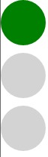
Async GUI programming
Controlling semaphore light
Using int or enum to keep current state?
Difficult to read – what does state represent?
Better approach – asynchronous waiting
Loop switches between state
Asynchronous waiting for events

Slide 23
Writing loops using workflows
Using standard language constructs
Key idea – asynchronous waiting
F# events are first class values
Can use functional & imperative style
Infinite loop!
let semaphoreStates() = async {
while true do
for current in [ green; orange; red ] do
let! md = Async.AwaitEvent(this.MouseDown)
display(current) }
Wait for click

Slide 24
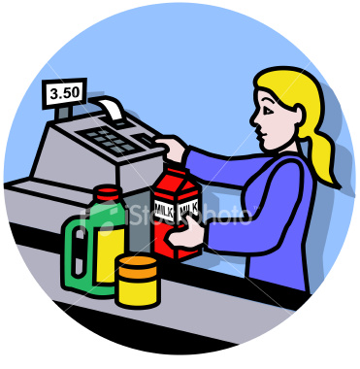
Checkout application workflow
Think of a simple while loop

Slide 25
Asynchronous and concurrent programming
Asynchronous GUI in Checkout example
Single-threaded thanks to Async.StartImmediate
Easy way to encode control flow
Parallel programming
Workflows are non-blocking computations
Run workflows in parallel with Async.Parallel
Concurrent programming
Compose application from (thousands of) agents
Agents communicate using messages

